Slide 1

Credit Card Fraud Detection Project
Enhancing security through advanced analytics. Learn how to detect and prevent credit card fraud using data-driven insights.
A
Akshatha Raj

Slide 2
Introduction
Uncover the importance of credit card fraud detection in today's digital world.
Explore the financial and trust implications of fraud for individuals and businesses.

Slide 3

Dataset Overview
Discover the key details of the credit card fraud dataset used in this project.
Explore a dataset of approximately 1.3 million transactions recorded over a two-year period.
Learn about the dataset's source and its generation using the Sparkov Data Generation tool.

Slide 4
Column Details
trans_date_trans_time: Date and time of the transaction.
cc_num: Credit card number (potentially masked for privacy).
merchant: Name or identifier of the merchant involved.
category: Categorization of the transaction (e.g., retail, dining).
amt: Transaction amount.
gender: Gender of the cardholder.
city_pop: Population of the city where the cardholder is located.
job: Occupation or job of the cardholder.
dob: Date of birth of the cardholder.
is_fraud: Binary indicator (0 or 1) for fraudulent transactions.
first and last: The first and last name of the cardholder, providing personal identification details.
street: Street address of the cardholder, contributing to location specifics.

Slide 5

Dataset Summary
Dataset Summary:
Transaction Amount Range:
Rows: 1,296,675
Minimum: $1.0 USD
Columns: 28
Maximum: $28,948.9 USD
Time Range:
City Details:
Start Date: 2019/01/01
Number of Cities: 894
End Date: 2020/06/21
Number of States: 21
Gender Distribution:
Population Range: 23 to 2,906,700
Females: 709,863
Age Constraint:
Males: 586,812
Minimum Age: 18
Merchant Information:
Target Variable:
Number of Merchants: 693
Fraudulent Transactions (is_fraud = 1): 7,506
Transaction Categories : 14
Non-Fraudulent Transactions (is_fraud = 0): 1,289,169

Slide 6

Exploratory Data Analysis (EDA)
Gain insights from the visual exploration of the credit card fraud dataset.
Identify patterns, anomalies, and correlations using various charts and graphs.
Examine temporal trends in transaction data to detect potential fraudulent activities.

Slide 7

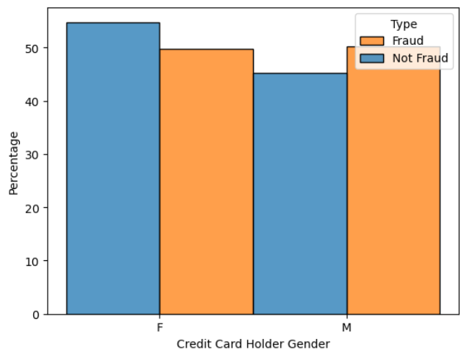
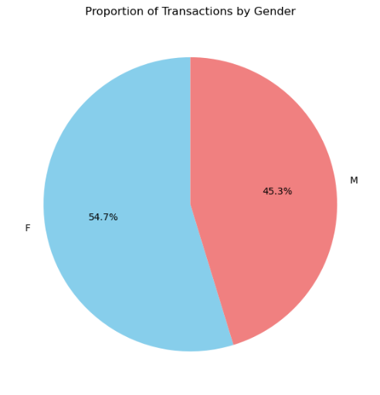
EDA
Gender is not very indicative of a fraudulent transaction.

Slide 8

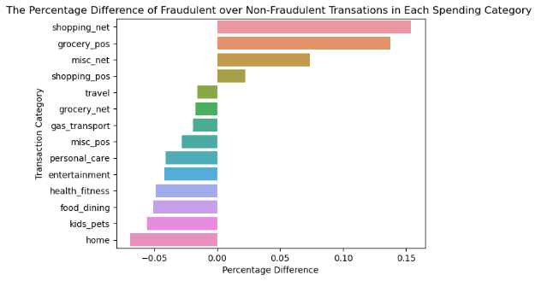
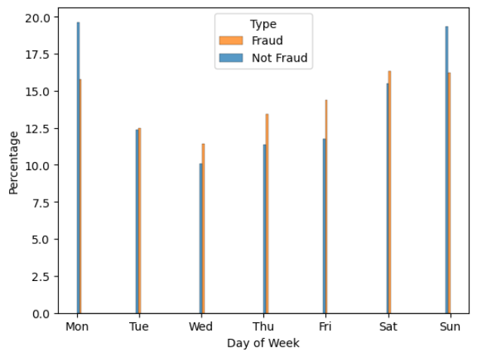
Fraud tends to happen more often in 'Shopping_net', 'Grocery_pos', and 'misc_net’
while 'home' and 'kids_pets' among others tend to see more normal transactions than fraudulent ones.
Normal transactions tend to happen more often on Monday and Sunday while fraudulent ones tend to spread out more evenly throughout the week.

Slide 9
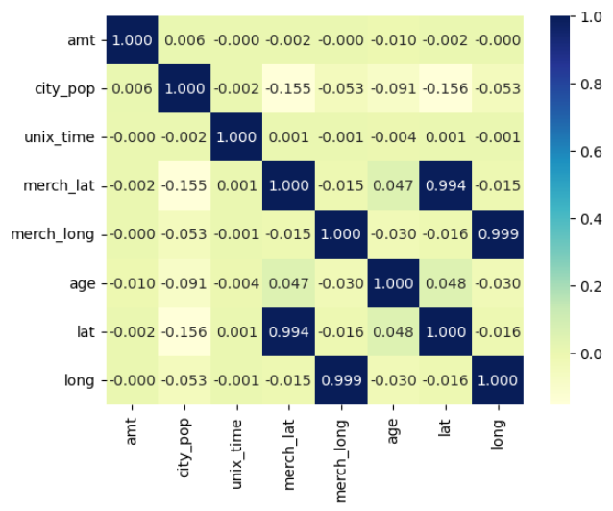
Strong Correlations:
merch_lat and lat (0.993):
A very strong positive correlation indicates that as the latitude of the merchant's location increases, the latitude of the cardholder's location also increases. However, this is likely unrelated to fraud.
merch_long and long (0.999):
An extremely strong positive correlation suggests that the longitude of the merchant's location is almost perfectly aligned with the longitude of the cardholder's location. Again, this seems unrelated to fraud.
Weak Correlations:
city_pop and age (-0.091):
A weak negative correlation implies that as the population of the city increases, the age of the cardholder slightly decreases. This correlation is not strong enough to draw a direct relationship to fraud.
2. merch_lat and age (0.047):
A very weak positive correlation suggests a minimal relationship between the latitude of the merchant's location and the age of the cardholder.
3. lat and age (0.048):
Another very weak positive correlation, indicating a slight connection between the latitude of the cardholder's location and their age.
3.No Significant Correlations:
amt, unix_time, merch_long, and other variables: These variables have correlations close to zero, suggesting no significant linear relationships with other variables. Thus, they may not strongly influence fraud detection.
Key Insights:
None of the analyzed correlations show a strong direct relationship with fraud.
Correlation alone doesn't establish causation or direct impact on fraud. Other factors and non-linear relationships
may be at play.
Consider more advanced techniques such as feature importance from machine learning models for a comprehensive analysis.

Slide 10

Key insights from the Exploratory Data Analysis (EDA):
Gender Distribution:
Females: 54.7%, Males: 45.3%.
Transaction Amount Patterns:
Normal transactions: <$200.
Fraudulent transactions peak: $300-$1000.
Spending Categories vs Fraud:
Fraud more in 'Shopping_net,' 'Grocery_pos,' 'misc_net.'
'Home' and 'kids_pets' have fewer frauds.
Age vs Fraud:
Potential fraud higher in ages 50-65.
Cyclicality of Credit Card Fraud:
Fraud peaks around midnight.
Weekly: Normal peaks Mon & Sun, frauds spread.
Monthly: Fraud concentrated Jan-May.
Seasonal Trend:
Transactions peak in summer, fraud slightly higher.
State vs Fraud:
Significant variations across states.
Correlation Analysis:
Strong positive correlations (merch_lat with lat, merch_long with long).
Weak correlations: city_pop and age, merch_lat and age, lat and age.
No significant correlations with transaction amount, unix_time, and others.
9. Key Points on Correlations:
Correlation doesn't imply causation.
Consider advanced techniques for a comprehensive analysis.
Overall Message:
Insights provide a clear understanding of transaction patterns, spending categories, age, temporal trends, and geographical influences on fraud.

Slide 11

Dataset Features
Get insights into the key features of the credit card fraud dataset.
Analyze transaction volume, involving 1000 customers and 800 merchants.
Explore features such as credit card number, merchant, amount, gender, and more.

Slide 12

Numerical Data Analysis
Analyze transaction amounts, ranging from 1 to 28,948.90 USD.
Explore the mean amount of 70.35 USD and the standard deviation of 160.32 USD.
Investigate ZIP codes, coordinates, and city populations for further insights.

Slide 13

Fraud Detection Timeline
1
Dataset Collection
Collect credit card transaction data from various sources.
2
Data Preprocessing
Clean and prepare the dataset for analysis by removing duplicates and handling missing values.
3
Feature Engineering
Create meaningful features from the raw data to improve fraud detection accuracy.

Slide 14

Next Steps
Model Training
Model Evaluation
Train machine learning algorithms on the prepared dataset to detect fraudulent transactions.
Evaluate the performance of the trained models using appropriate metrics and validation techniques.
Deployment
Implement the fraud detection model in real-world scenarios to enhance security and prevent financial losses.

Slide 15
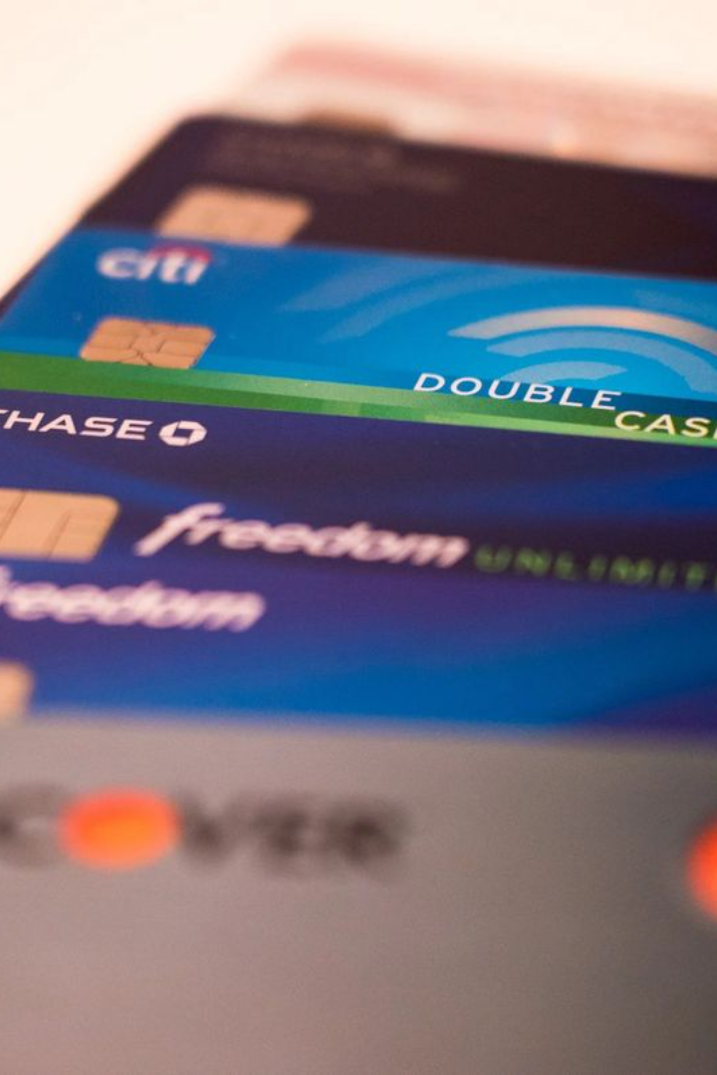
Determining the Objective
Problem Statement: Credit Card Fraud Detection
Objective: Develop ML model, Conduct Cost-Benefit Analysis, Provide Recommendations

Slide 16


Summary Statistics Interpretation
Transaction Amount (amt):
Ranged widely from 1 to 28,948.90 USD.
Mean amount: 70.35 USD, SD: 160.32 USD.
75% of transactions below 83.14 USD.
ZIP Code (zip):
Diverse values with a mean of 48,800.07.
Geographic Coordinates (lat and long):
Broad geographical spread with mean lat: 38.54, long: -90.23.
City Population (city_pop):
Significant variation, mean: 88,824.44, max: 2,906,700.

Slide 17
Categorical Data Analysis
Merchant Information:
Various merchants with "fraud_Kilback LLC" having the highest frequency.
693 unique merchants in the dataset.
Transaction Categories:
Various categories with "gas_transport" having the highest frequency.
"Travel" category with the fewest transactions.
Transaction Amount Subset:
Examined a subset with entries ranging from 1.06 to 1,376.04 USD.

Slide 18
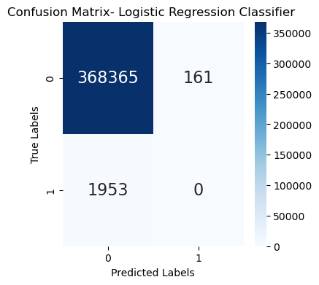
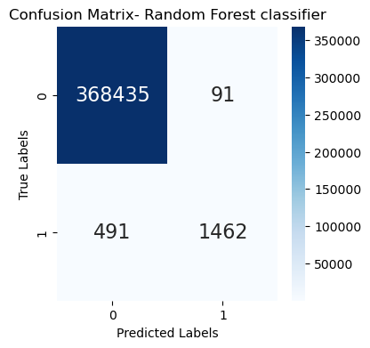
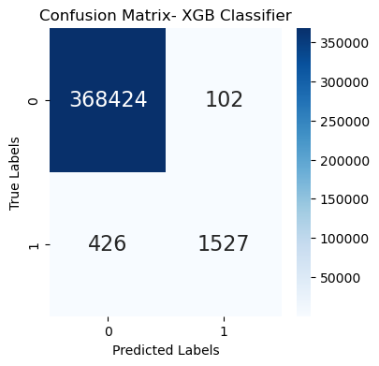
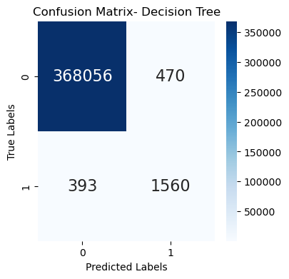
Model Building
Models Used:
Logistic Regression, Random Forest, XGBoost, Decision Tree.
Performance Metrics:
Accuracy, Precision, Recall, F1-Score.
Random Forest Model:
Achieved an accuracy of 99.78% with a precision of 94% and recall of 75%.

Slide 19
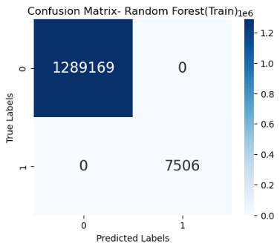
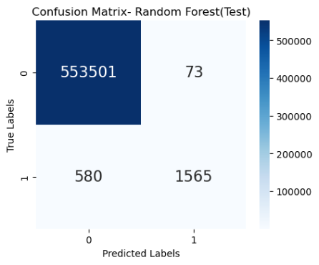
Evaluation Metrics
Random Forest Metrics: Accuracy, Precision, Recall, F1-Score
Accuracy of Train Data: 100.0
Precision : 100.00
Recall : 99.98
F1 – Score :99.99
Accuracy of Test Data: 99.88249457009748
True Positive Ratio : 72.96037296037296
False Positive Rato : 0.013187035518286623
Precision : 95.54334554334555
F1 - Score : 82.73856727464975

Slide 20
Feature Importance
Top Features:
log_amt (Logarithm of Transaction Amount)
category_grocery_pos
category_misc_net
category_shopping_net
category_travel
Insights:
Unusual log-transformed amounts flagged for potential fraud.
Certain spending categories show higher susceptibility to fraud.

Slide 21
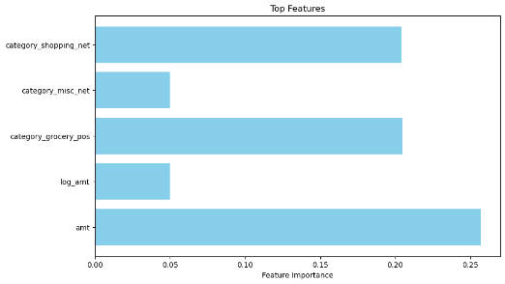
Key Factors Impacting Fraud Transactions:
1.log_amt (Logarithm of Transaction Amount):
2.category_grocery_pos:
3.category_misc_net:
4.category_shopping_net:
5.category_travel:
6.amt (Transaction Amount)
7.city_pop (City Population)
8.hour (Transaction Hour)
9.age (Customer Age)
category_gas_transport

Slide 22

Strategic Approach
Overview of your strategic approach for fraud detection:
Comprehensive Analysis : In-depth examination of various transaction features.
Pattern Identification : Goal: Identify patterns linked to fraudulent activities.
Leveraging Technology : Use of machine learning and statistical methods.
Enhanced Fraud Detection : Objective: Strengthen fraud detection capabilities.
Customer Security Focus : Aim: Ensure a secure financial environment for customers.
Strategic Implementation : Adoption of strategic methods for effective fraud prevention.
Advanced Techniques : Utilization of machine learning for sophisticated analysis.
Statistical Methods : Incorporation of statistical tools for robust insights.
Continuous Improvement : Commitment to ongoing enhancements in fraud prevention.
Customer-Centric Approach:
Prioritization of customer security and trust.

Slide 23

Proposal:- 1
Biometric Confirmation
Introducing Fingerprint Authentication can provide numerous benefits for secure user verification. Our implementation strategy ensures a seamless experience while providing an extra layer of security. Advantages include faster login times and reduced risk of password breaches.

Slide 24

Benifit
Reduced Fraud Risk:
Physical presence required for transactions.
Minimizes unauthorized transaction risks.
Customer Trust:
Demonstrates commitment to safeguarding assets.
Builds trust and confidence.
Mobile Adaptability:
Aligned with mobile transaction trends.
Secure and convenient for on-the-go users.
Conclusion:
Strategic Security Reinforcement:
Incorporating fingerprint authentication is a strategic move.
Best Practices Alignment:
Aligns with industry security best practices.
Leadership Position:
Establishes leadership in ensuring financial services' security.

Slide 25
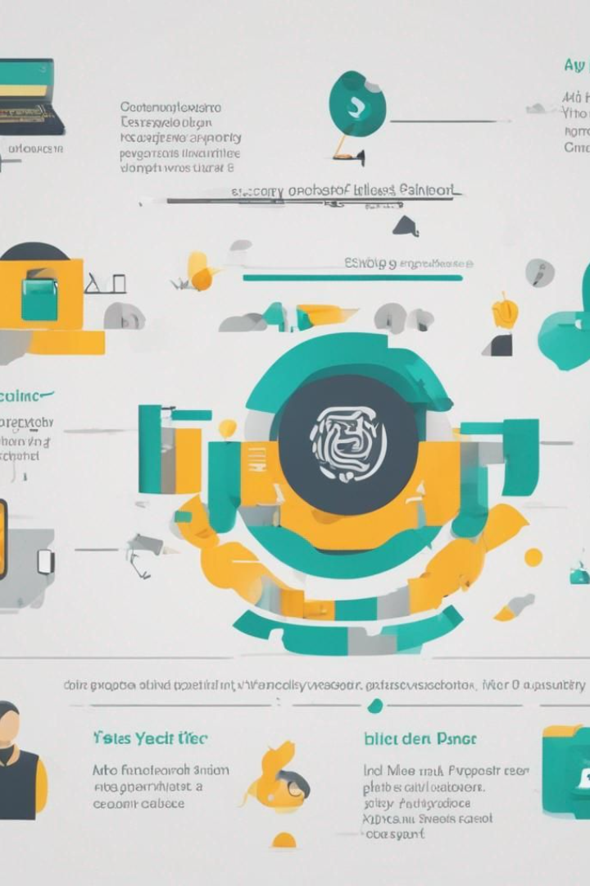
Proposal:- 2
Two-Step Verification
FINGERPRINT :
Considering the vulnerability of elderly customers to fraudulent activities, our Two-Step Verification system combines iris and fingerprint recognition for enhanced security. It offers advantages such as enhanced security, user-friendly experience, and accessibility features. Implementation steps include customer engagement, education campaign, enrollment support, test phase, gradual rollout, and continuous support.

Slide 26
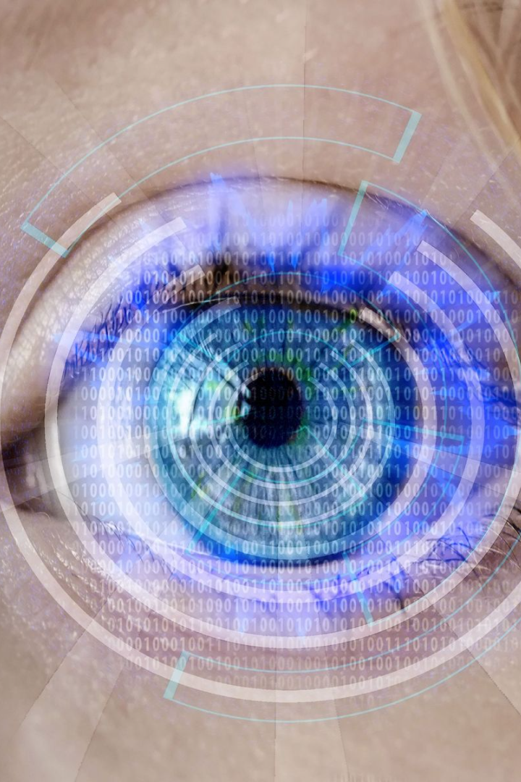
Proposal - Two-Step Verification
Iris or Face Recognition
Background:
Elderly customers are often targeted by fraudulent activities.
Two-Step Verification:
Combines iris and fingerprint recognition for enhanced security.
Advantages: Enhanced Security, User-Friendly, Accessibility Features.
Implementation Steps:
Customer Engagement, Education Campaign, Enrollment Support, Test Phase, Gradual Rollout, Continuous Support.

Slide 27

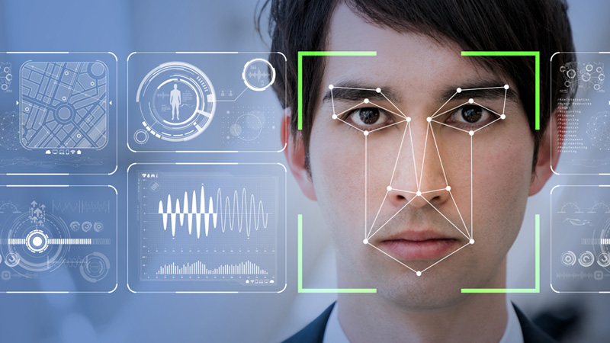
Advantages
Enhanced Security for Elderly Customers - Two-Step Verification
Iris Recognition:
High Security:
Utilizes unique patterns in the iris for authentication.
Offers a level of security beyond traditional methods.
Non-Intrusive:
Non-intrusive method for enhanced user comfort.
Fingerprint Authentication:
Complementary Security Layer:
Adds an extra layer of security in conjunction with iris recognition.
Widely accepted and convenient biometric method.
Seamless User Experience:
Ensures a smooth and user-friendly authentication process.
Conclusion:
Holistic Security Approach:
Combining iris recognition and fingerprint authentication for robust security.
User-Centric Design:
Prioritizing security without compromising user experience.
Enhanced Protection:
Two-step verification ensures heightened protection for elderly customers.

Slide 28

Advantages of Two-Step Verification:
Enhanced Security:
High Security Standard:
Combining iris and fingerprint recognition raises the security bar significantly.
Challenging for fraudsters to gain unauthorized access.
User-Friendly for Elderly Customers:
Designed for Ease:
Tailored to address potential challenges elderly customers may face with traditional security methods.
Ensures a user-friendly experience.
Accessibility Features:
Inclusive Design:
Compatibility with accessibility features to accommodate customers with diverse needs.

Slide 29

Implementation Strategy:
Customer Engagement:
Informative Communication:
Initiate a communication plan highlighting security benefits and user-friendly aspects.
Emphasize the ease of use.
Education Campaign:
Guided Enrollment:
Provide tutorials and FAQs for a smooth enrollment process.
Ensure elderly customers are well-guided through the steps.
Enrollment Support:
Dedicated Assistance:
Establish dedicated support channels for secure enrollment of iris and fingerprints.
Address any concerns promptly.
Test Phase:
Reliability Assurance:
Conduct thorough testing to ensure the reliability and accuracy of the dual verification process.
Gradual Rollout:
Pilot Implementation:
Initiate a pilot phase with a select group of elderly customers.
Gather feedback and make necessary adjustments.
Continuous Support:
Ongoing Assistance:
Maintain continuous support to address concerns or queries.
Ensure a smooth transition for elderly customers.

Slide 30


